Slide 1


Final-Review Presentation
26 June, 2025
Automated Analytical Tool for MM Reports
(Material Management)
Presented by: Aanchal Jain
Manager: Mr. Shailesh Kumar Chauhan, RIL
GET Summer’25 Intern
Mechanical Engineering(4ᵗʰ year)
Birla Institute of Technology, Mesra

Slide 2




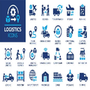


PROCUREMENT & CONTRACTING (Materials Management)
PROCUREMENT & CONTRACTING (Materials Management)
Material Management Processes
Overview
→
→
1. Planning
2. Procurement
3. Receiving
Material requirement planning
Purchase from approved vendors
Goods Receipt Note (GRN)
PO (Purchase Order) creation
Quality inspection
→
5. Reporting
→
4. Storage
6. Inventory
Stock monitoring
Performance metrics
Warehouse management
Reorder point management
Trend analysis
The
Automated Analytical Tool
focuses on optimizing processes 2-6 through data-driven insights

Slide 3





Key Challenges in Materials Management Reporting
High Volume and Diversity of Reports:
Materials Management reports are vast and varied, making it difficult to navigate and extract relevant information quickly
Delayed Access to KPIs and Insights:
Business users do multiple operations on data to derive KPI and insights , which slows down timely decision-making
Manual and Time-Consuming Analysis:
Most reporting processes rely heavily on manual effort, leading to inefficiencies and increased chances of error
Limited Visibility into Trends and Processes:
The absence of real-time insights makes it challenging to track trends or manage processes effectively
These challenges highlight the need for an
automated analytical solution
to streamline material movement reporting
Notes:
1.7.2013
4
‹#›

Slide 4


Key Objectives of the Intelligent MM Analytical Tool
OBJECTIVES
Automate insight generation by transforming uploaded MM reports into actionable intelligence.
Enable real-time access to KPIs for faster and more informed decision-making
Boost operational efficiency by streamlining reporting and reducing manual effort
Optimize inventory and service levels through data-driven management
Facilitate proactive monitoring with dynamic dashboards and trend analysis.
Report Automation
Inventory Optimization
KPI Tracking
Data driven insight

Slide 5


PROCUREMENT & CONTRACTING (Materials Management)
Technical and
Functional Deliverables
Technical Deliverables
Functional Deliverables
Upload interface for Excel files downloaded directly from SAP
Automated data cleaning & validation
Web based platform for trends & insights
Interactive dashboard with charts & KPIs
Export to PNG/ Excel Formats.
Filter integration for GRN & MB51 datasets.
Error Handling for empty or incorrect file
GRN processing time analysis (MRR to GRN)
Total value of received material
Identify materials missing PO delivery date
Vendor-wise performance analysis
PO Item missed (%) calculation and visual representation
MB51 movement type analysis (Total GRN, Total Issue, Total Return)
Dynamic KPIs

Slide 6



PROCUREMENT & CONTRACTING (Materials Management)
Project
Timeline
8-Week Implementation Plan
Weeks 1-2
Requirements gathering and analysis
Dataset exploration and understanding
Data cleaning and preprocessing
Weeks 3-4
Streamlit application framework setup
Data processing pipeline implementation
Weeks 5-6
Core visualization components
Advanced analytics implementation
Dashboard refinement and optimization
Filter integration and interactive features
Weeks 7-8
Integrating requested suggestion with insights into the tool
Final presentation and walkthrough of the complete tool

Slide 7




PROCUREMENT & CONTRACTING (Materials Management)
Dataset
Description
GRN Completion Data
MB51 Data
Size:
132 rows
Columns:
34
Size:
617,423 rows
Columns:
66
Key Columns:
Key Columns:
MRR NO.
MRR Date
MRR required Qty.
Reason Code Delay
Material
Posting Date
Quantity
Entry Date
Purchase Order
Item
Area
Unit of Measurement
Vendor
Movement Type
Material
Amount in LC
Purpose/Use:
Purpose/Use:
GRN Processing Time, UOM Analysis, Top Vendor, Delay Reason
Movement Type Analysis, Material Analysis, No. of materials missed the PO delivery date
PO Delivery Date Data
Size:
328 rows
Columns:
17
All datasets are processed through
jupyter Notebook & Streamlit application
Key Columns:
Purchasing Document
Item
Delivery Date
Material
Vendor
Data is cleaned, validated, and transformed before analysis
Purpose/Use:
For merging with MB51 to identify missed delivery dates
Relationships between datasets are established using common keys

Slide 8

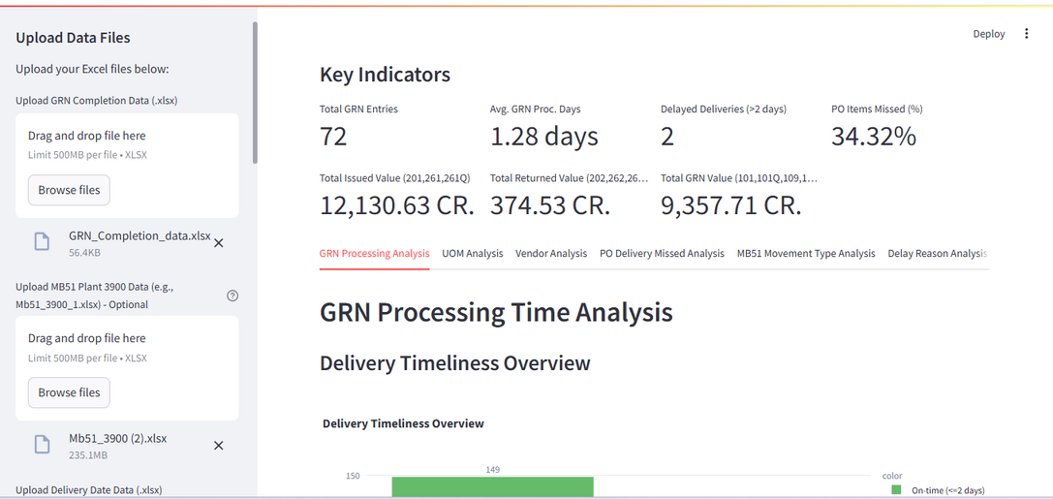
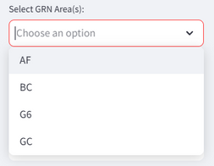
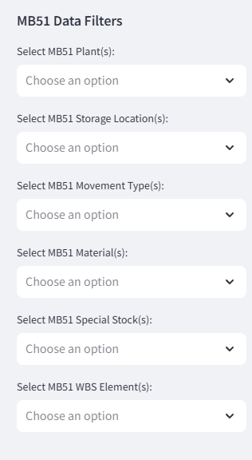
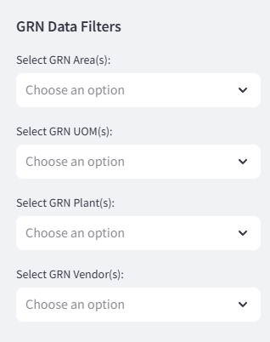
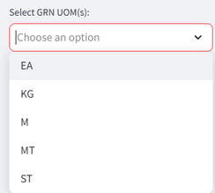

Tool Discription And Processes Involved
Description
Tool uploads GRN, MB51, PO data and shows KPIs like GRN time, line items, and delays through real-time charts.
DASHBOARD OVERVIEW
FILTERS OPTIONS
First page preview of uploaded PDF
Dataset upload options (GRN, MB51, PO)
Tabs for key indicators and detailed analysis
Interactive GRN/MB51 filters
Detailed Analysis Options
Custom analysis Features

Slide 9








Tool Discription And Processes Involved
Tool Description and
Processes Involved
Dashboard Overview
Key Features
The tool uploads GRN, MB51, and PO data to generate real-time KPIs and visualizations for material movement analysis.
Interactive Filters
Custom Analysis
Detailed Analysis
Multiple Dataset Support
1
Data Upload (GRN, MB51, PO files)
Analysis Tabs
2
Automated Data Processing & Cleaning
GRN Processing
PO Delivery Analysis
3
Analysis & Insight Generation
UOM Analysis
Movement Type Analysis
4
Interactive Dashboard Visualization
Vendor Analysis
Delay Reason Analysis

Slide 10


PROCUREMENT & CONTRACTING (Materials Management)
Analysis Tabs Description
GRN PROCESSING ANALYSIS
UOM
ANALYSIS
PO DELIVERY MISSED ANALYSIS
VENDOR ANALYSIS
Average GRN Processing Days by UOM.
Total MRR Requested Quantity by UOM
UOM-wise Average GRN Processing Days and Total Quantity Issued per AREA
PO Line Item Delivery Performance Summary
PO Line Items with Quantity Discrepancies
Delivery Timeliness Overview
Details of Delayed Deliveries
Top 10 Vendors by GRN Count
Vendor Summary (Total Count & Value)

Slide 11

PROCUREMENT & CONTRACTING (Materials Management)
Analysis Tabs Description
MB51 MOVEMENT TYPE ANALYSIS
DELAY REASON ANALYSIS
MATERIAL ANALYSIS
Movement Type Categories Summary (GRN, Issues, Returns)
Top 10 Materials Comparison (GRN, Issued, Returned)
Detailed Analysis by Selected Movement Types
Comparison of Selected Movement Types
WBS Analysis
Top 10 Materials by Amount in Local Currency (LC)
MRR Counts by Reason Code and Delay Type
TPN to MRR
MRR to MMX
Bar Chart
Pie Chart

Slide 12
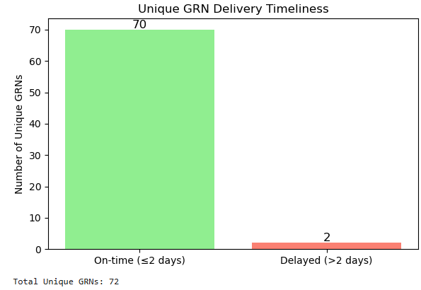


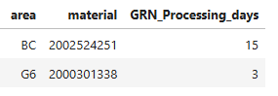


PROCUREMENT & CONTRACTING (Materials Management)
GRN Processing
Analysis
1.28 Days
72
2
Avg. GRN Processing Days.
Total GRN Entry
Delayed Deliveries (>2 days)
Key Findings
34.3% of deliveries exceeded the target processing time of 2 days
Processing time peaks during high-volume periods (month-end)
Reason capturing for the delay at GRN.
Dataset used : GRN Completion data

Slide 13
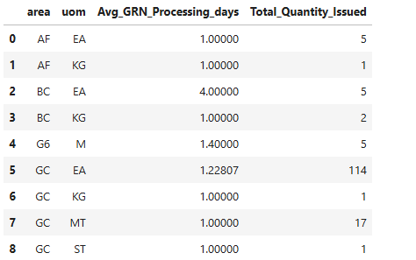
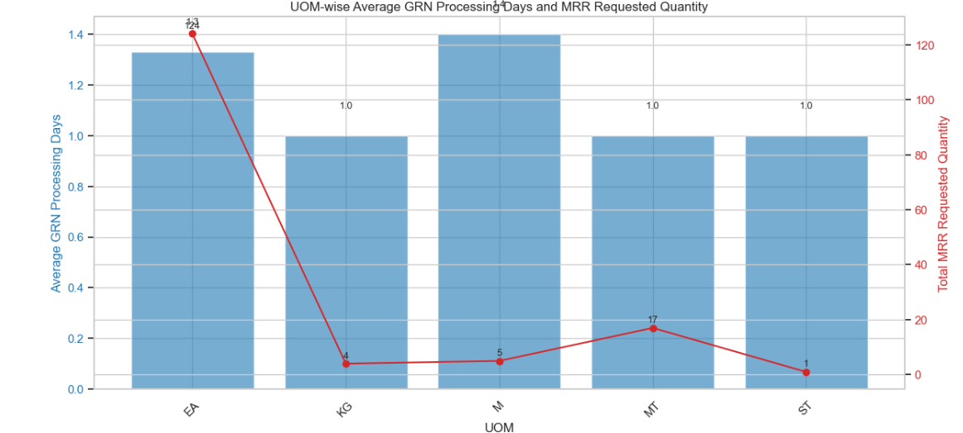

PROCUREMENT & CONTRACTING (Materials Management)
UOM
Analysis
GRN_Count
Key Insights from UOM Analysis
M (Meter) units have the highest average processing time at 1.4 days
EA (Each) represents the highest total quantity by value
indicating higher demand
KG (Kilogram) units show the most consistent processing times
EA (Each) units show high quantity UOMs with low delays indicate efficiency
Dataset used : GRN Completion data and Delivery Data

Slide 14
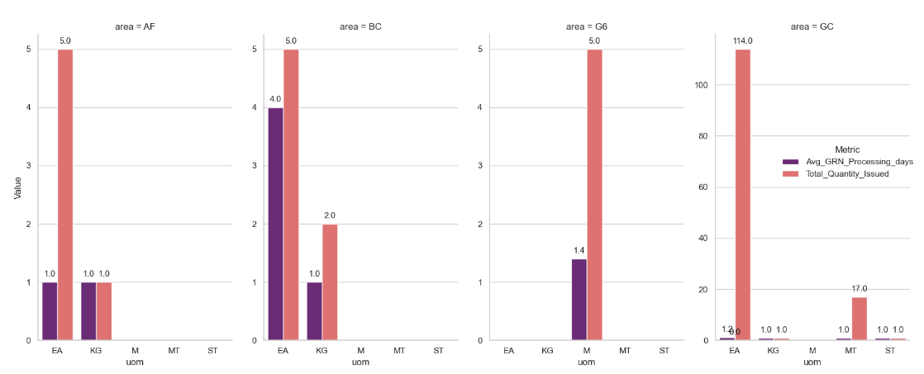
PROCUREMENT & CONTRACTING (Materials Management)
UOM
Analysis
UOM-wise Average GRN Processing Days and Total Quantity Issued per AREA
High Efficiency in Area GC: Area GC processes 114EA and 17MT with just 1-day GRN time , showing top efficiency
Potential Delay in Area BC: Area BC shows a higher GRN processing time (4 days) for UOM EA, unlike other areas — this may signal a process inefficiency or delay in that unit.

Slide 15

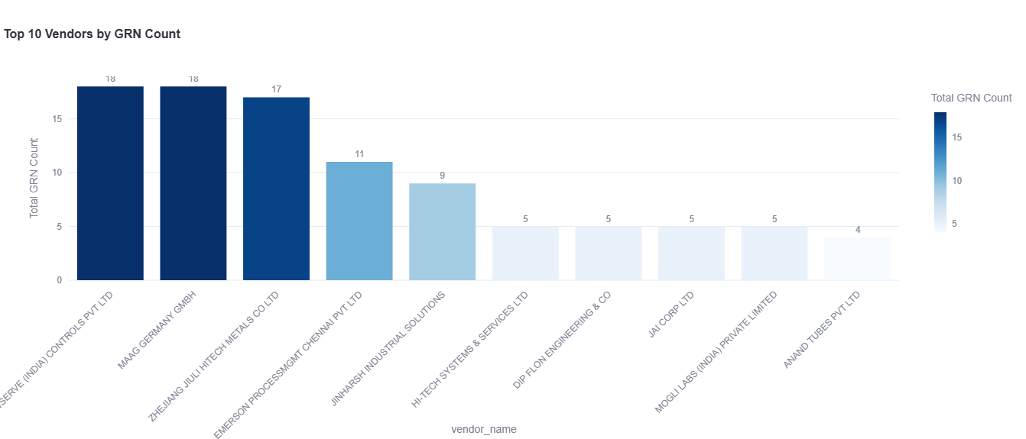
PROCUREMENT & CONTRACTING (Materials Management)
Vendor
Analysis
Top Vendors by Total Value
Top 10 Vendors by GRN Count
Vendor
GRN Count
Total Value (₹)
FLOWSERVE (INDIA) CONTROLS PVT LTD – 18
JAI CORP LTD
5
460.35 Lacs
MAAG GERMANY GMBH – 18
JOHN CRANE SEALING SYSTEMS INDIA
3
190.95 Lacs
ZHEJIANG JIULI HITECH METALS CO LTD - 17
PEP CEE PACK INDUSTRIES
2
116.13 Lacs
POSITRONICS PVT LTD
1
109.05 Lacs
BS&B SAFETY SYSTEMS (INDIA) LTD
2
105.02 Lacs
Key Insights
Top 5 vendors account for 75% of total GRN transactions.
Top GRN Count: Flowserve and Maag – 18 GRNs
JAI CORP LTD, has the highest GRN value (₹460.35 lakh), indicating fewer but high-value transactions.

Slide 16
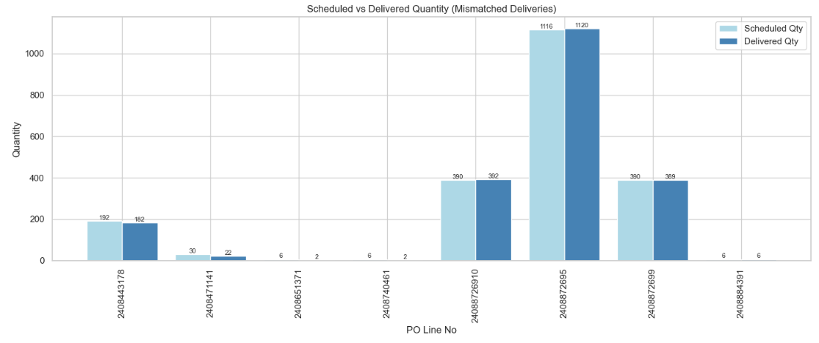

PROCUREMENT & CONTRACTING (Materials Management)
Purchase Order Delivery
Missed Analysis
1247
34.32%
428
Total GRN Entries Analyzed
Overall Missed Delivery Rate
PO Line Items Missed
Key Findings
34.32% of GRN deliveries were missed, indicating frequent delays.
428 PO line items had discrepancies in delivery quantity or timeline
Derived from merged MB51 & Delivery Date datasets using PO line No. as key

Slide 17
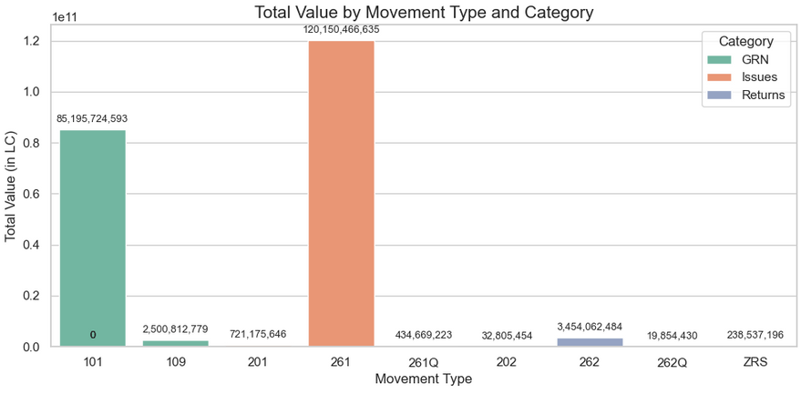
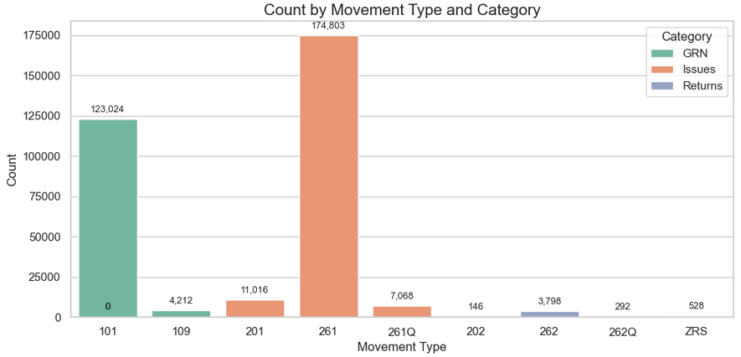
PROCUREMENT & CONTRACTING (Materials Management)
MB51 Movement Type
Analysis
Movement Type Categories Summary (GRN, Issues, Returns)
Movement Type Categories Summary
GRN (Goods Receipt Note)
By Value: NAPTHAPC_ORYX
₹3,787.36 Cr
By Count: BIOMASS
2,996 items
Issued
By Value: NAPTHAPC_ORYX
₹45,323.79 Cr
By Count: NGASRG01
5,913 items
Returned
By Value: NAPTHAPC_ORYX
₹994.54 Cr
By Count: NGASRG01
205 items
Key Insights
NAPTHAPC_ORYX dominates value across all movement types
Issue transactions represent 86% of total material value

Slide 18
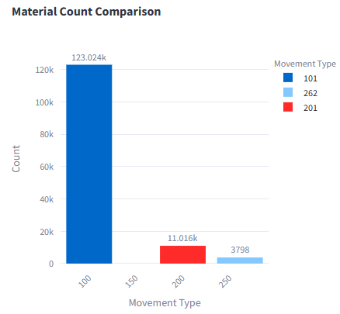
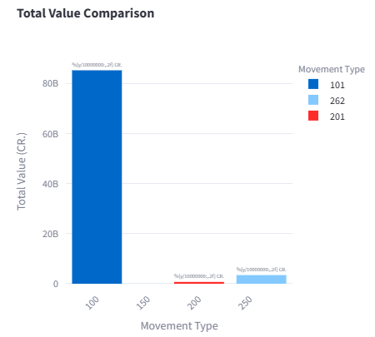
PROCUREMENT & CONTRACTING (Materials Management)
TAB 5. MB51 Movement Type Analysis
Comparison of Selected Movement Type
Material Count Comparison
Total Value Comparison

Slide 19

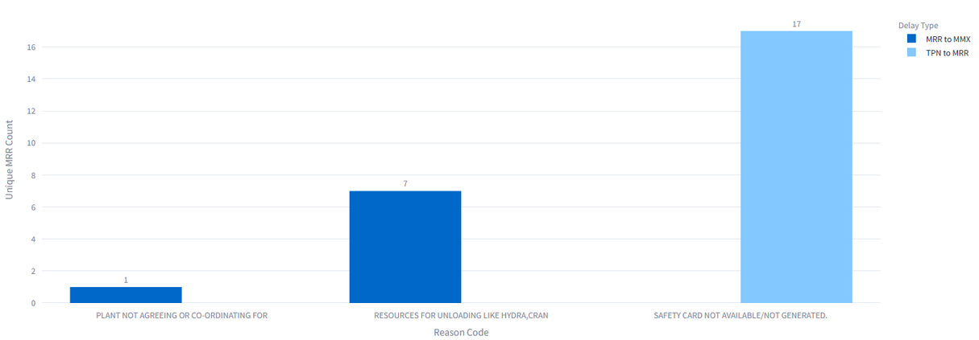

PROCUREMENT & CONTRACTING (Materials Management)
Delay Reason
Analysis
Delay Types Comparison
TPN to MRR Delays
55 delays with no specific reason recorded
MRR Counts by Reason Code and Delay Type
"Safety card not available" is the most common specific reason
MRR to MMX Delays
64 delays with no specific reason recorded
Fewer reason-specific delays compared to TPN to MRR
Key Insights
Unspecified reasons account for 62% of all delays
Implementing mandatory reason codes could improve tracking
Safety documentation process needs optimization
Dataset: GRN Completion data

Slide 20
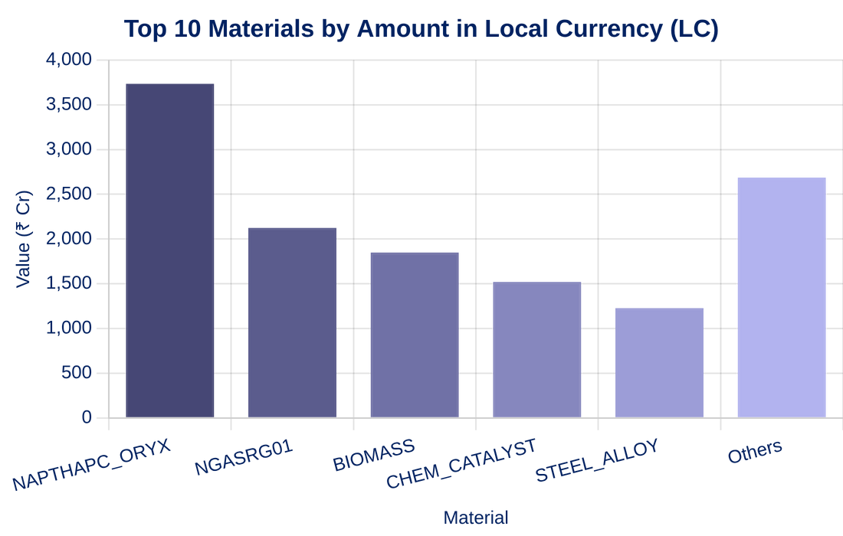
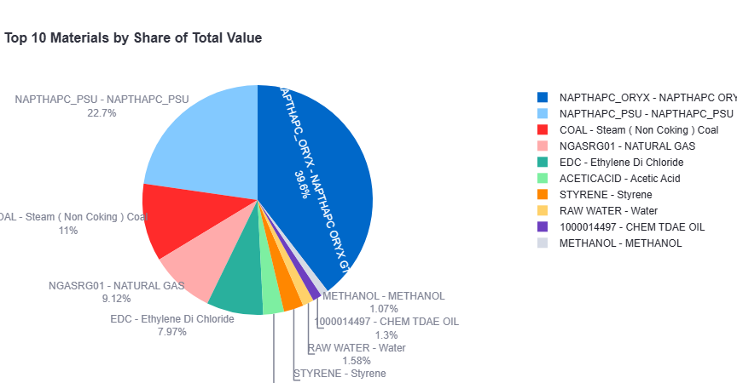
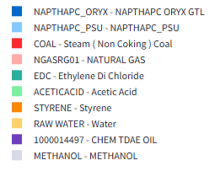

PROCUREMENT & CONTRACTING (Materials Management)
Material
Analysis
Bar Chart
Pie Chart
Top Materials by Value
Material
Value (₹ Cr)
% of Total
NAPTHAPC_ORYX
8,618.10
39.6%
NAPTHAPC_PSU
4,948.89
22.7%
COAL
2,387.12
11%
NGASRG01
1,985.95
9.12%
EDC
1,736.65
7.97%
Key Insights
Top 5 materials account for 90.39% of total value
NAPTHAPC_ORYX has highest value but moderate transaction count

Slide 21
PROCUREMENT & CONTRACTING (Materials Management)
STRUCTURE
TIME SAVING
EASE OF ACCESS
IMPACTS
INTERPRETABLE ANALYSIS
AND VISUALISATION
DATA DRIVEN DECISION MAKING

Slide 22
PROCUREMENT & CONTRACTING (Materials Management)
PROCUREMENT & CONTRACTING (Materials Management)
THANK YOU!

